Slide 1
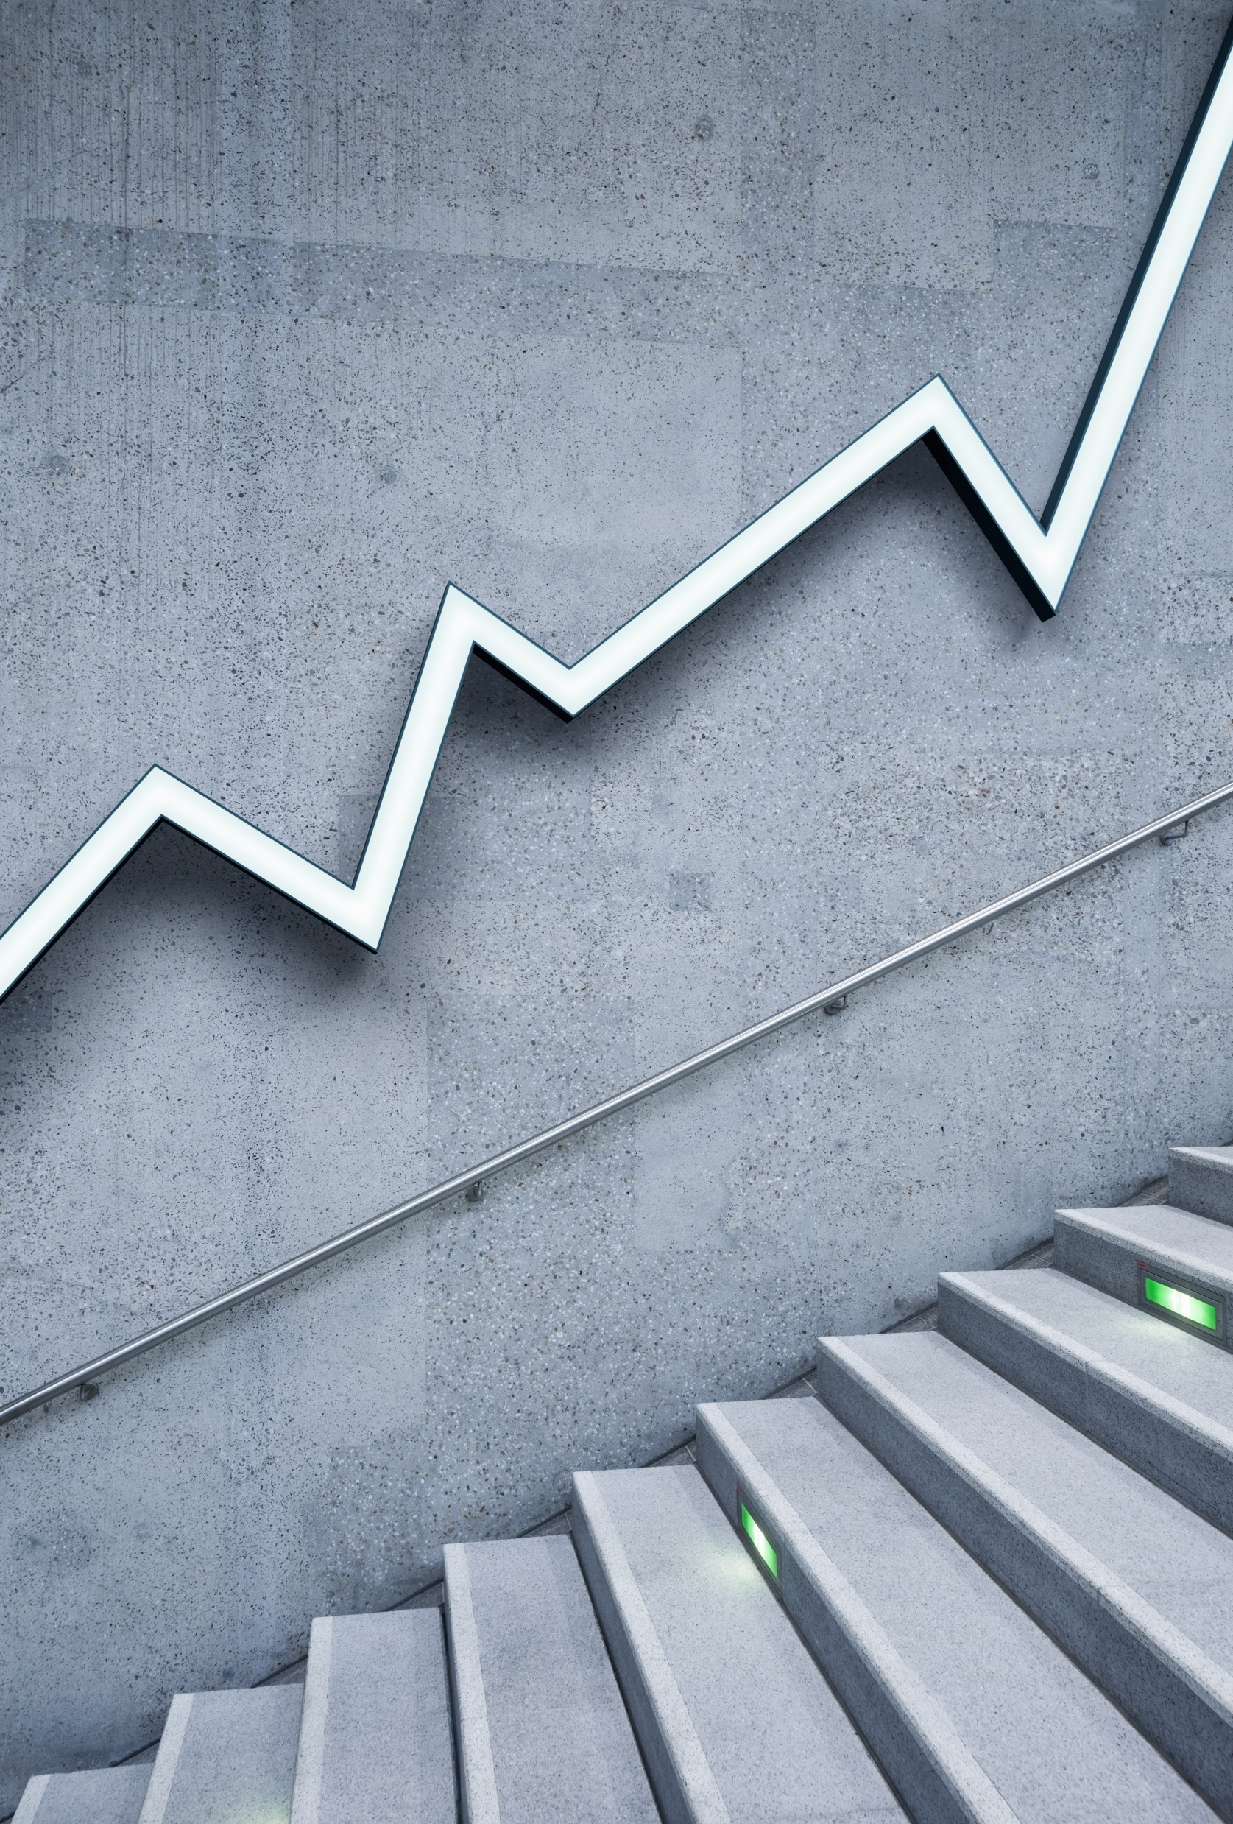
Title: WoRLD of World
Submitted By:
Abhinav Mani Tripathi
Aishwarya Ravi
Awanish Tiwari
Nupur Roy Chowdhury

Slide 2
WoRLD or World Revenue Longitudinal Data is compilation of government tax and non-tax revenues from IMF's Government Financial Statistics. It's strength lies primarily in the breadth of its countries and time. This dataset can be used to encourage the analytical work on revenue, policy and administration, and macro fiscal policy more generally, particularly in relation to developing economies. In this project we will pe predicting the GNI for 2040 using TS analysis.
INTRODUCTION

Slide 3
Objective
To extract the country level data for all the countries of this World.
Preprocess the extracted data into our required dataframe.
Identify the correlation between the indicators and their impact on GDP of country.
Clubbing and Sorting indicators to have more robust result.
Training Models and check their accuracy
Time Series Analysis of GDP of USA.

Slide 4
WORKFLOW
Collection of Raw Data
Data Acquisition and Pre- Processing
Dataset formation and final dataframe creation
Exploratory Data Analysis
Visualization of Attributes
Modelling
Time Series Analysis

Slide 5
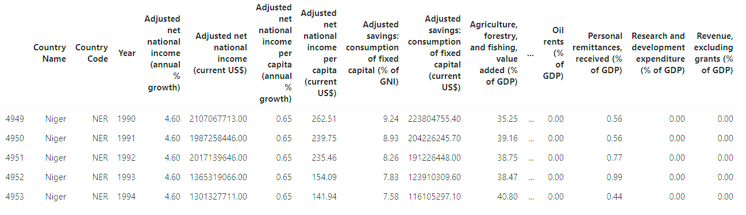
Visualization
Data Visualization

Slide 6
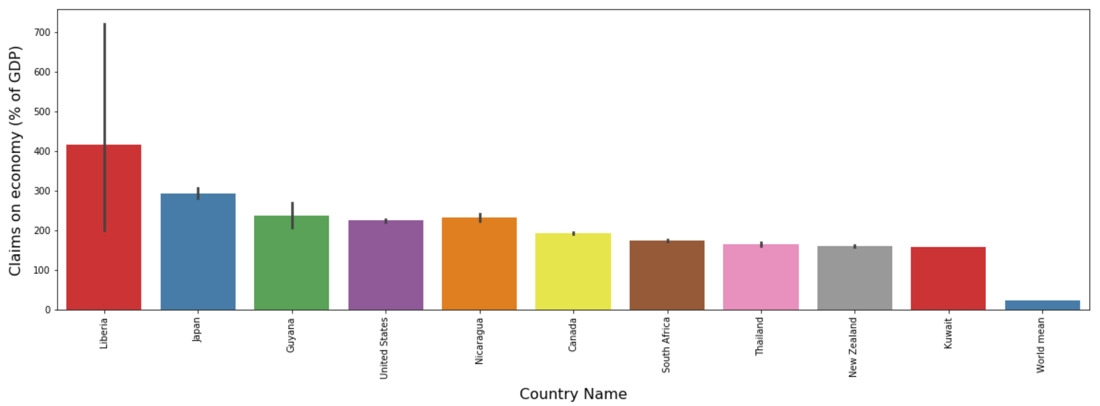
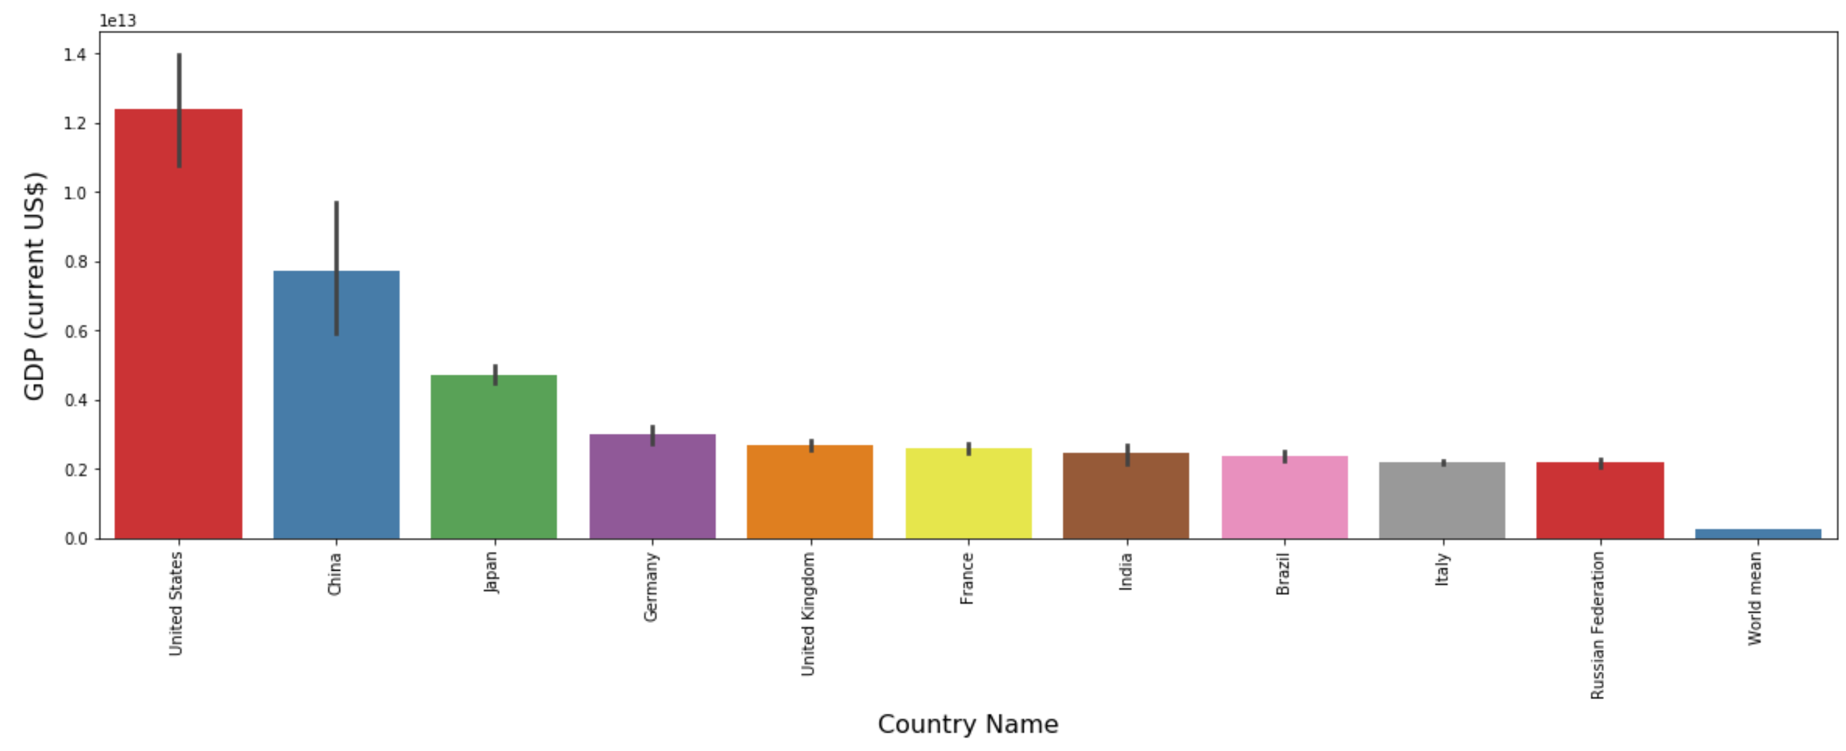
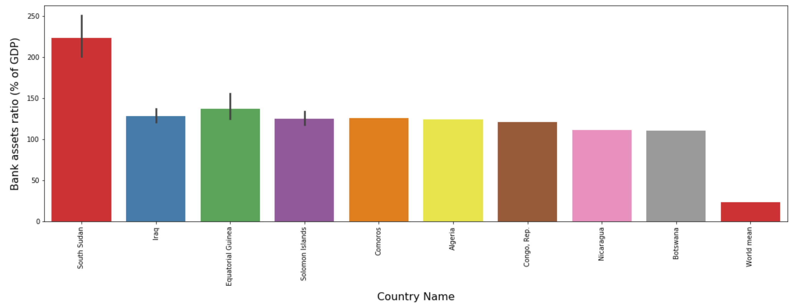
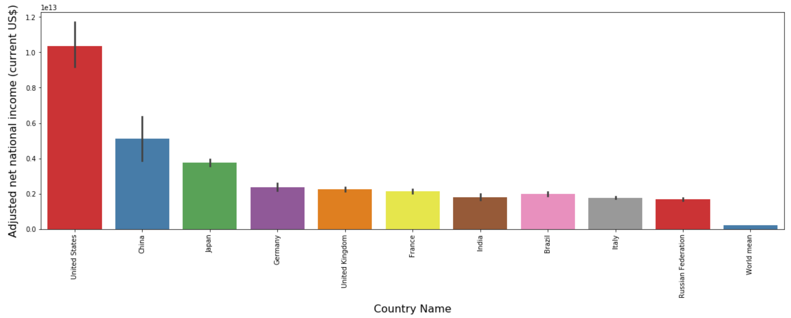
Attributes Visualization
Top 10 Countries with higher claims on economy
Top 10 Countries in Terms of GDP
Top 10 Countries with higher Bank asserts ratio
Top 10 Countries with Higher Net National income

Slide 7
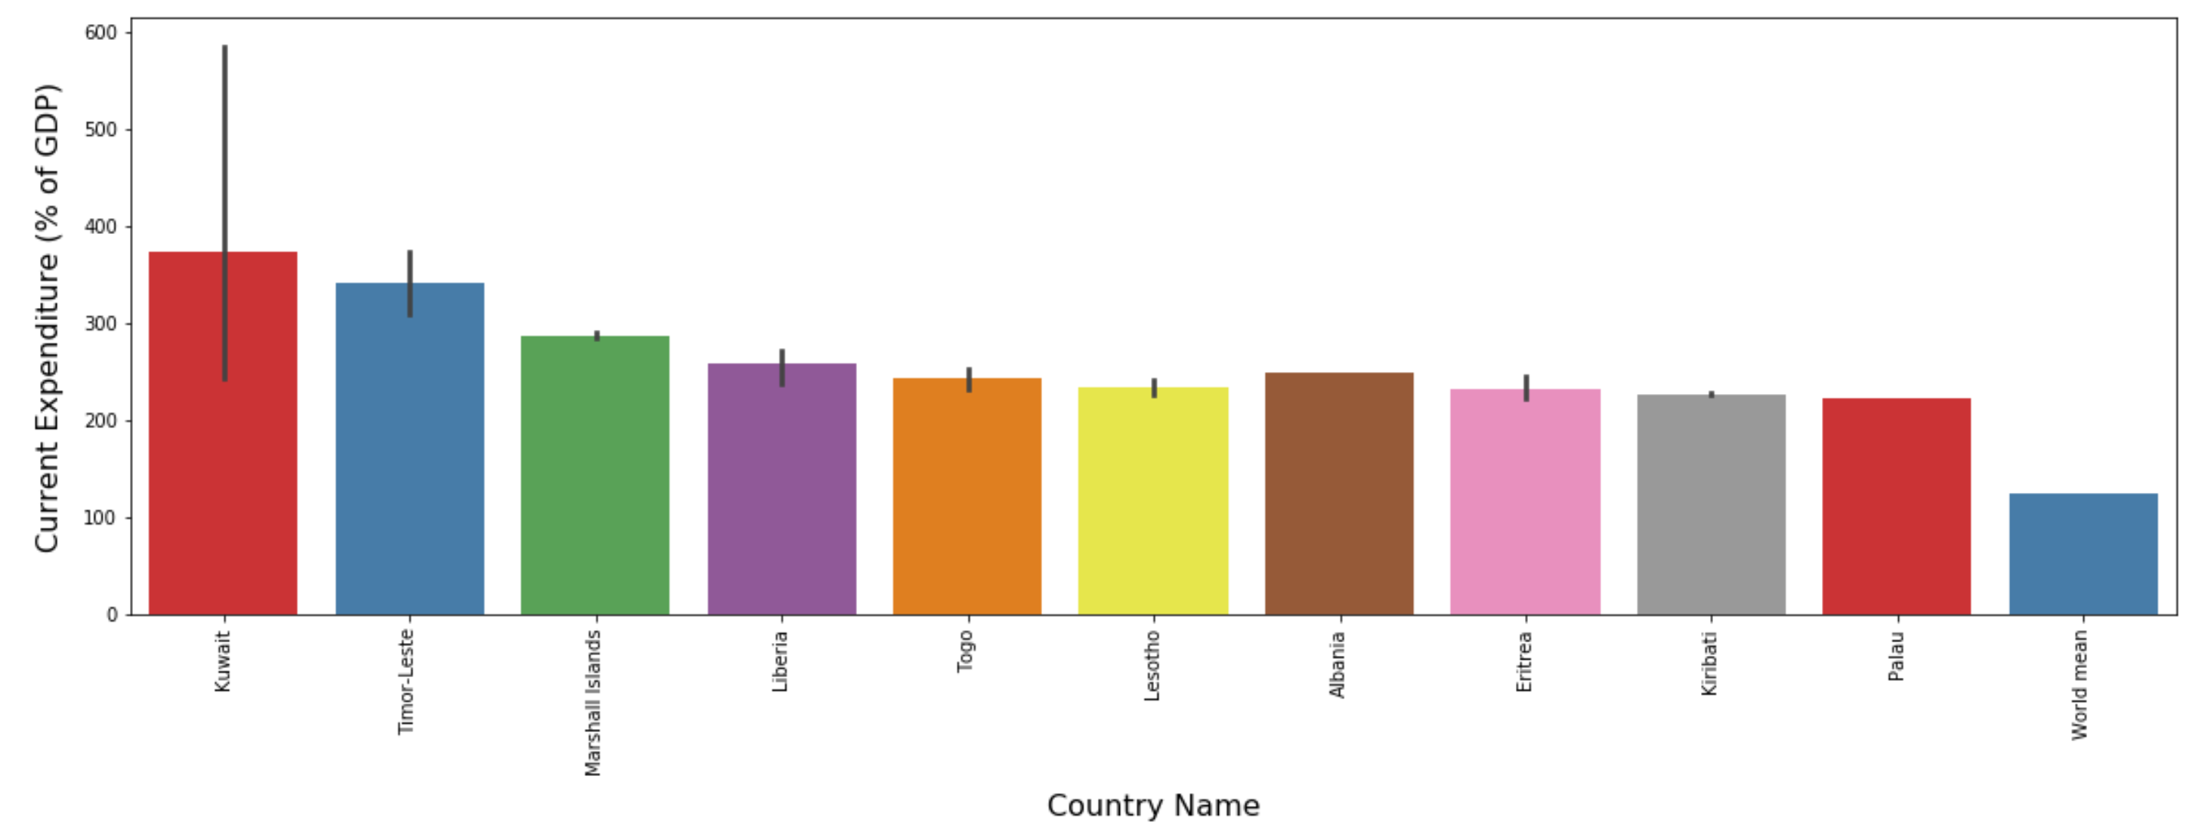
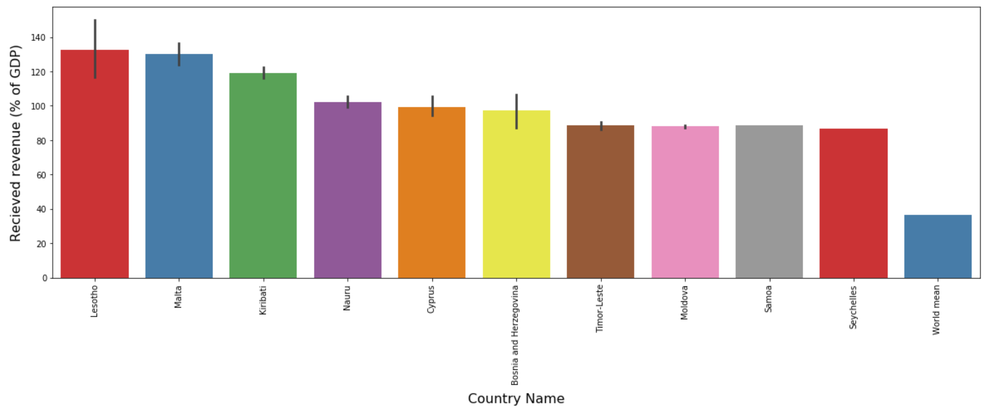
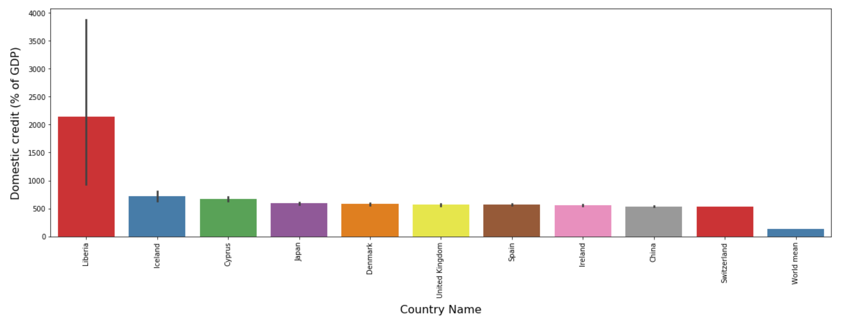
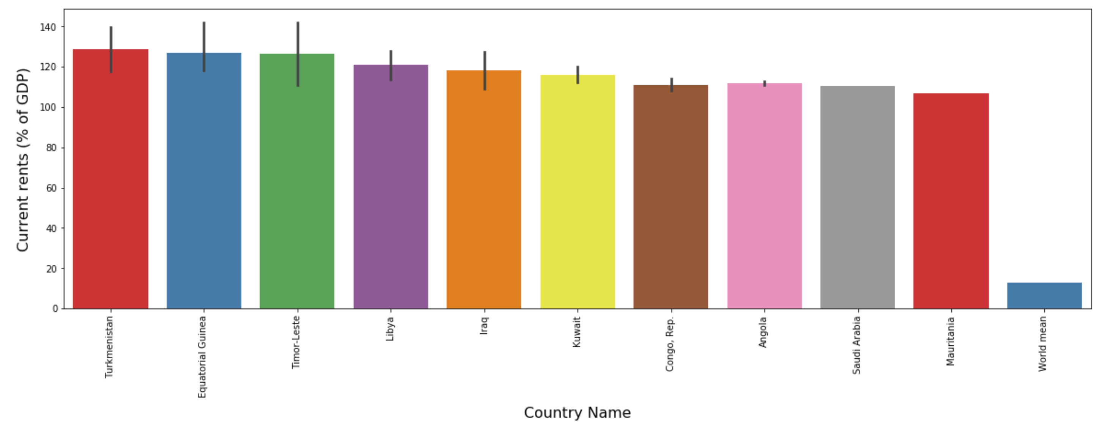
Attributes Visualization(Contd..)
Top 10 Countries with higher Current Expenditure
Top 10 Countries with higher Received Revenue
Top 10 Countries with higher Domestic credit
Top 10 Countries with higher Current rents

Slide 8
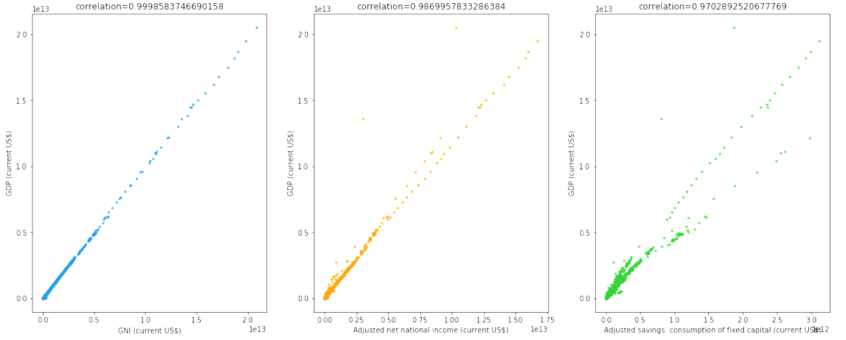
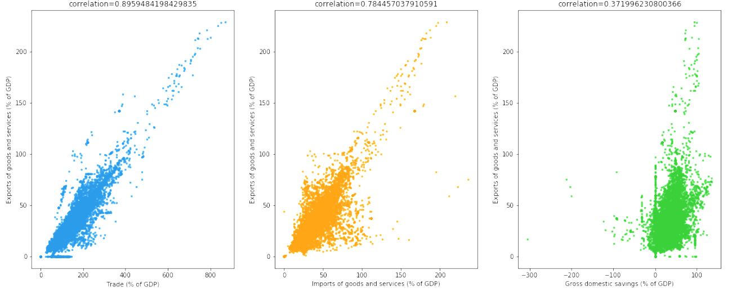
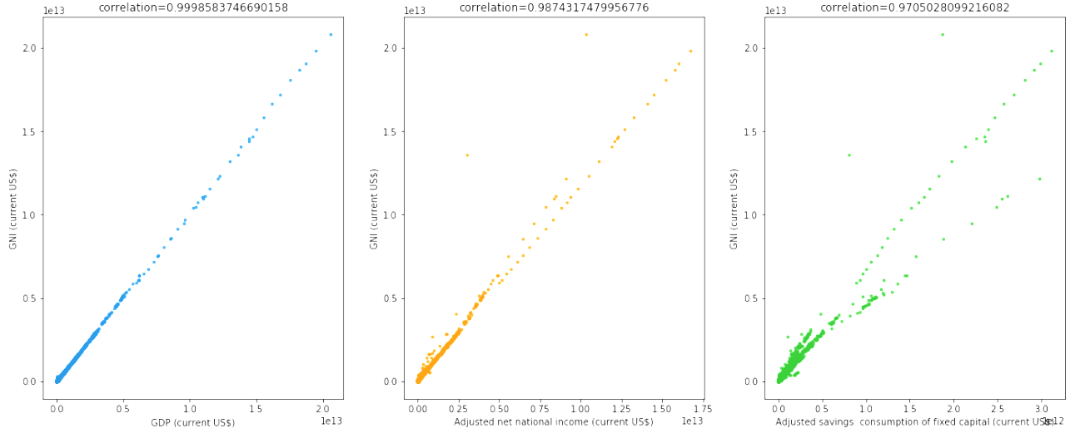
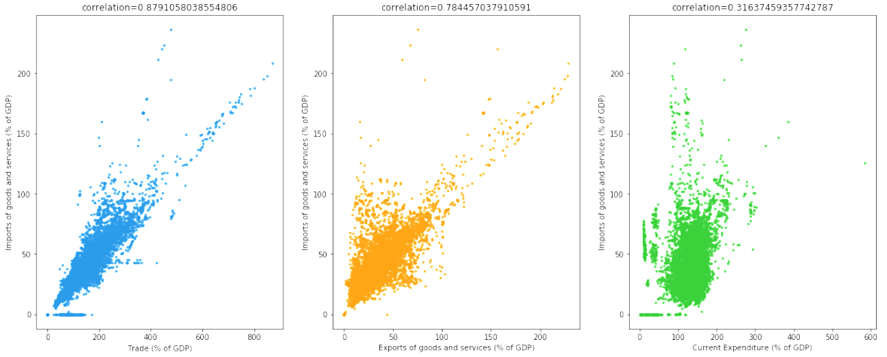
Scatter Plots
GDP
Exports of Goods & Services
GNI
Imports of Goods & Services

Slide 9
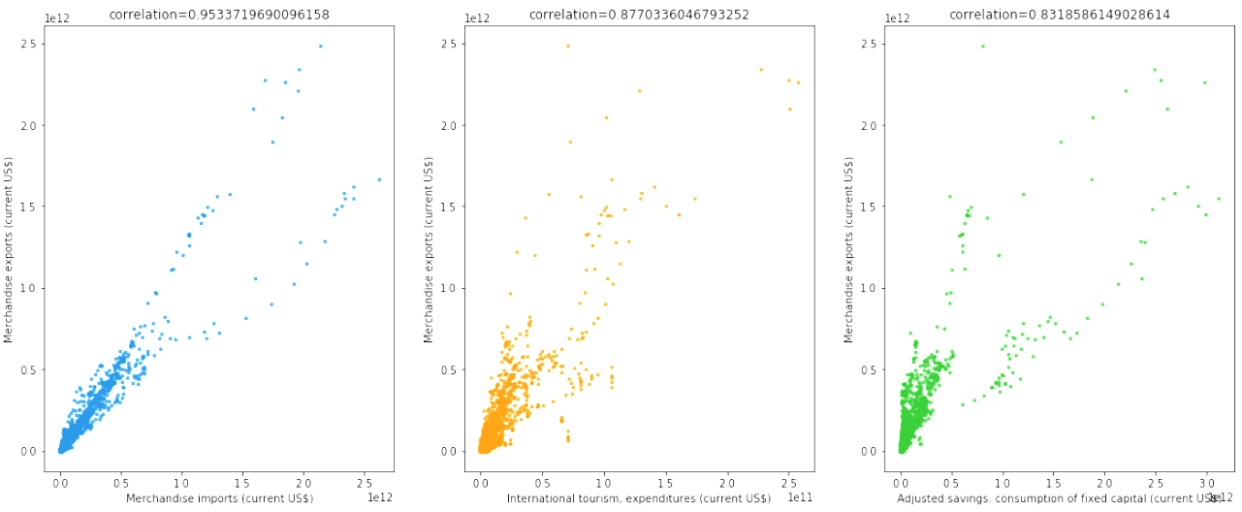
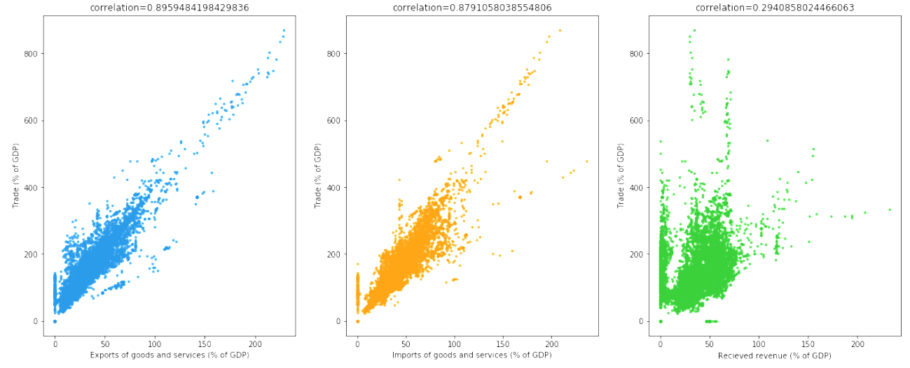
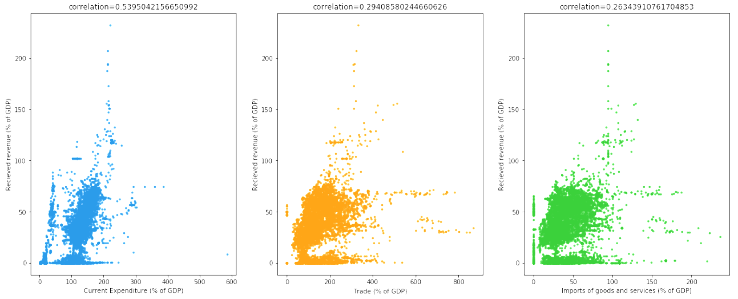
Scatter Plots(Contd..)
Merchandise exports
Trade
Received revenue

Slide 10
MODELS USED
Single Linear Regression Model
Multivariate Linear regression Model
Multivariate Linear regression with LabelEncoder Model
Random Forest
Decision Tree
KNeighbour Regression
Model Conclusion:- There is tough fight between Decision tree and KNeighbour but the best result is shown by KNeighbour Regression model with lowest RMSE and highest Accuracy, though just slight variation, so the winner is KNeighbour Regression model.

Slide 11
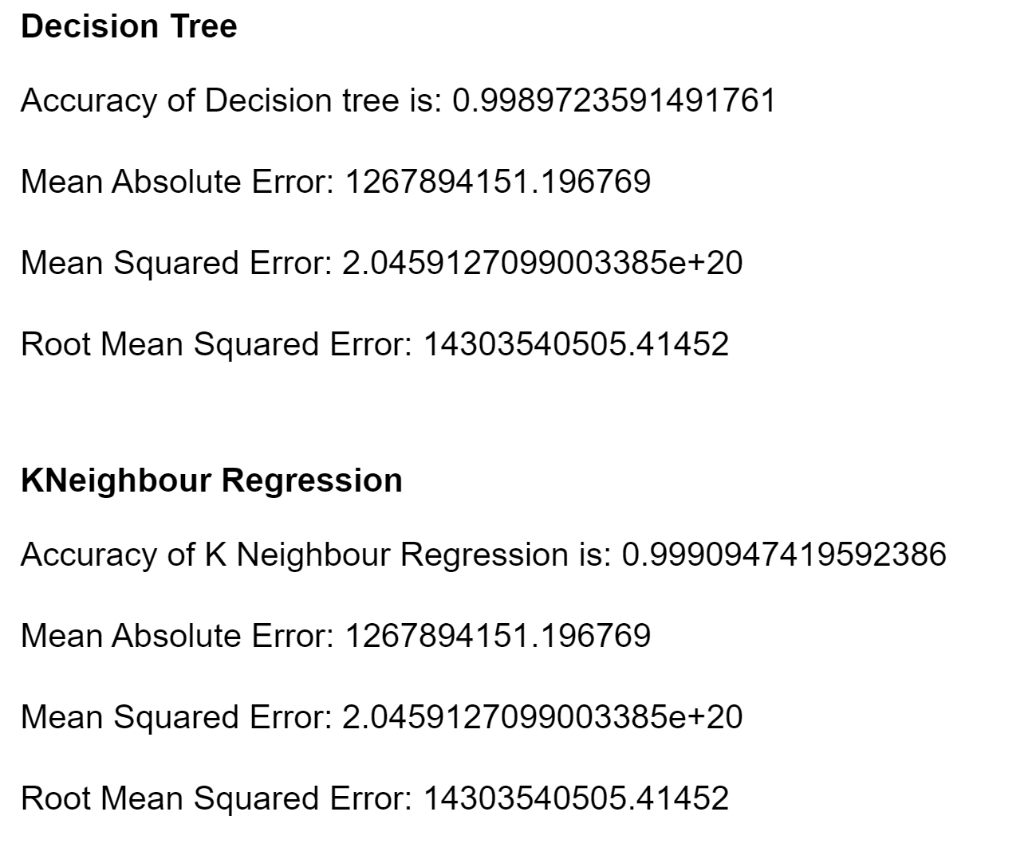
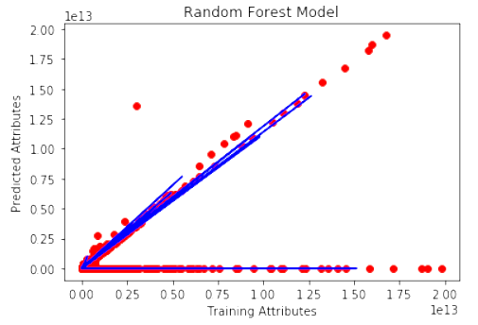
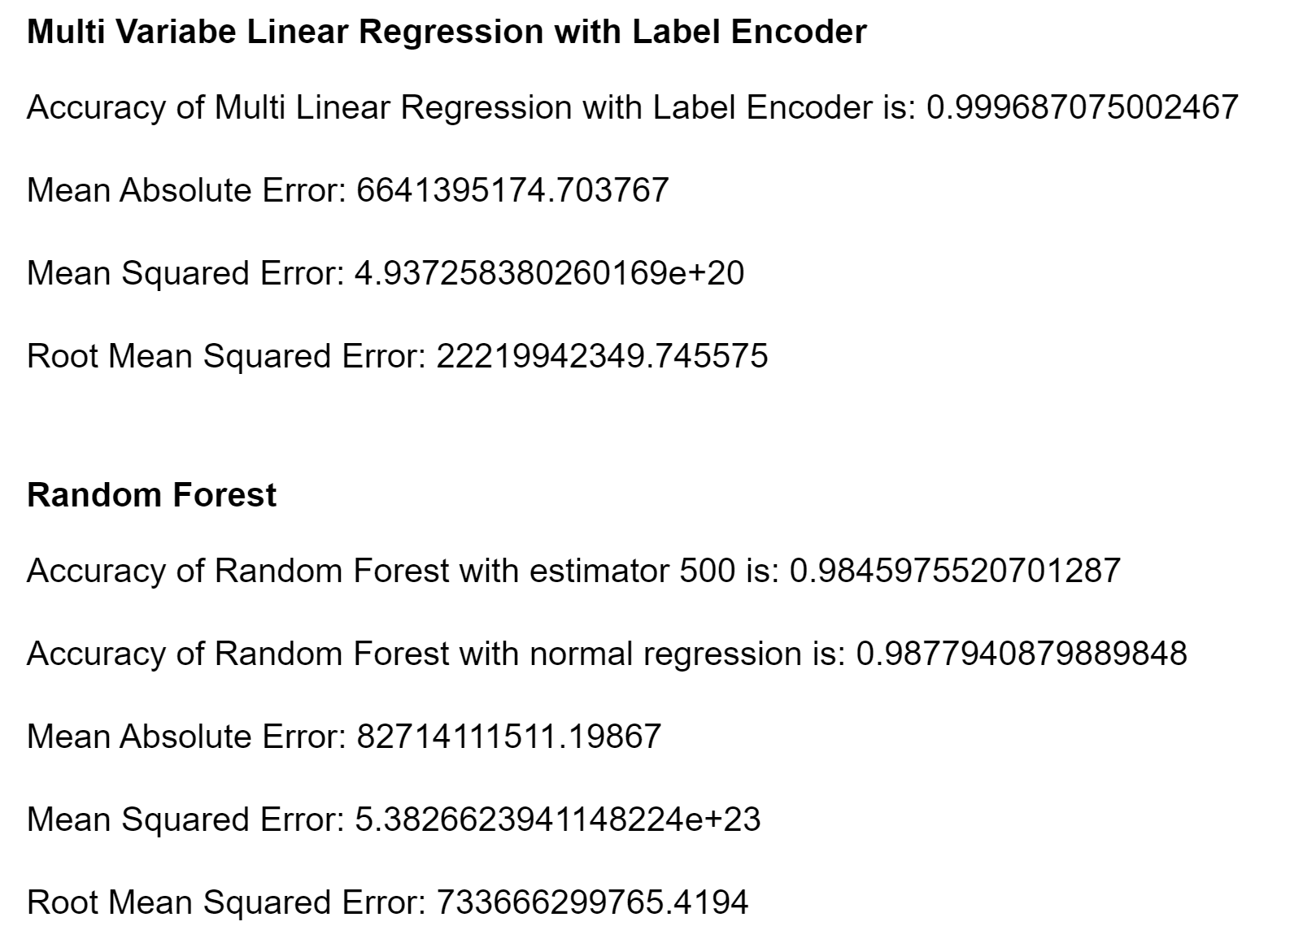
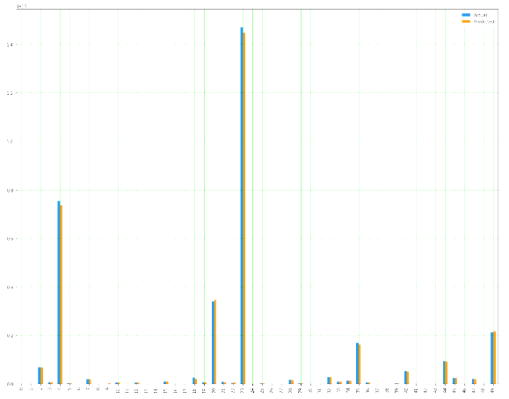
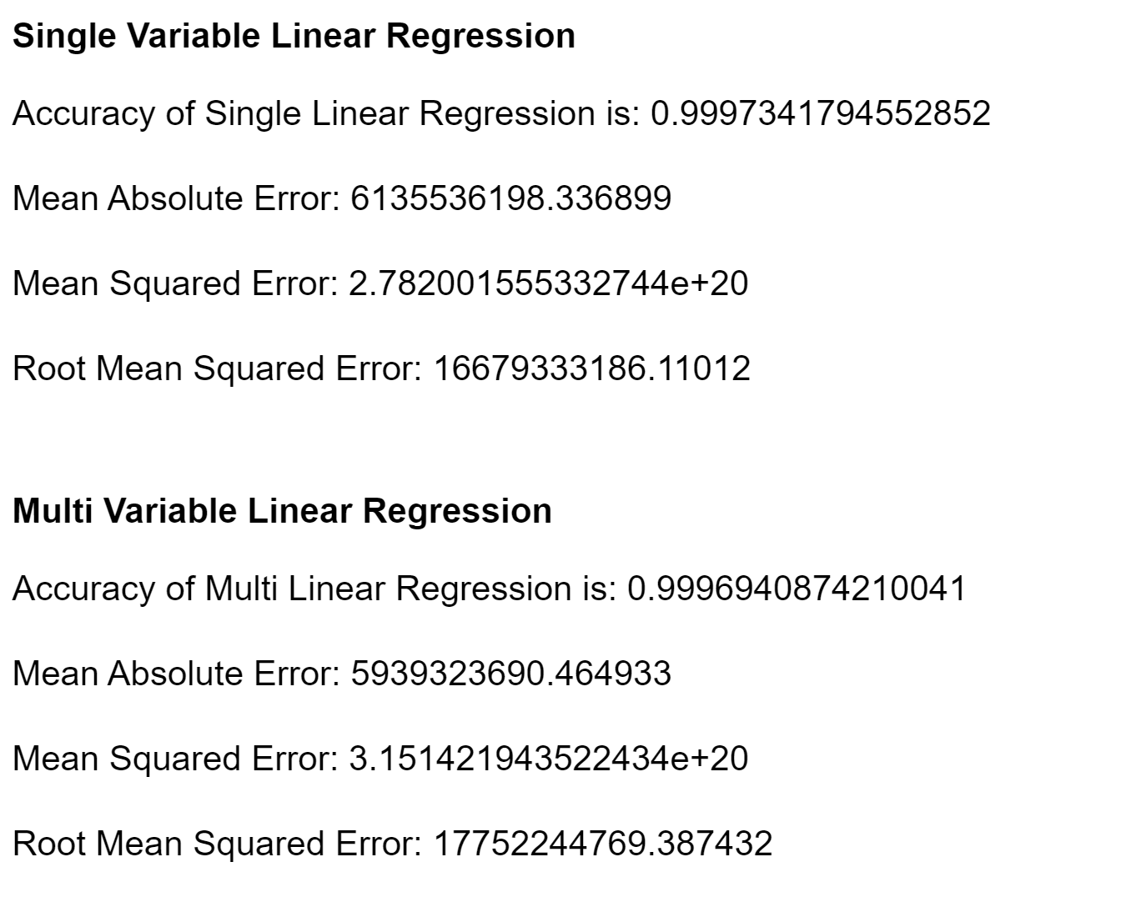
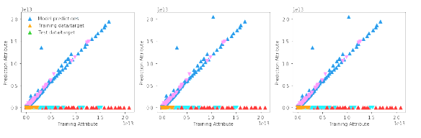
MODEL Result

Slide 12
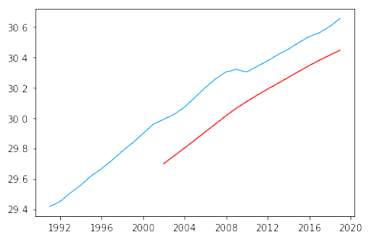
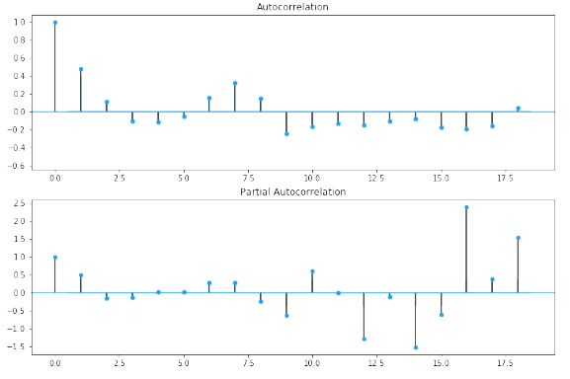
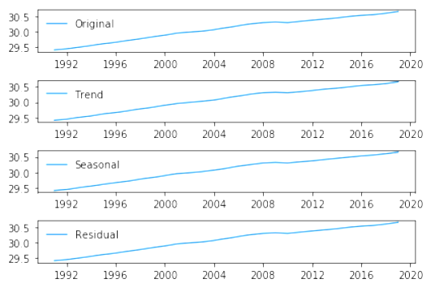
Time Series Analysis of GNI (USA)
Preparing time series dataframe
Check for stationarity
Removing stationarity seasonality and trend
Modeling
Predicting Values
Auto-Regressive Model
Moving average model
Auto-Regressive Integrated Moving Averages Model
Rescaling
Forecasting values of next 20 years

Slide 13
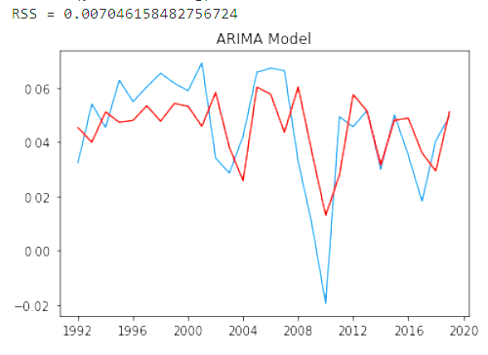
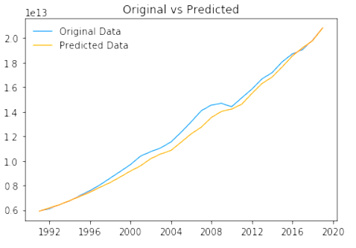
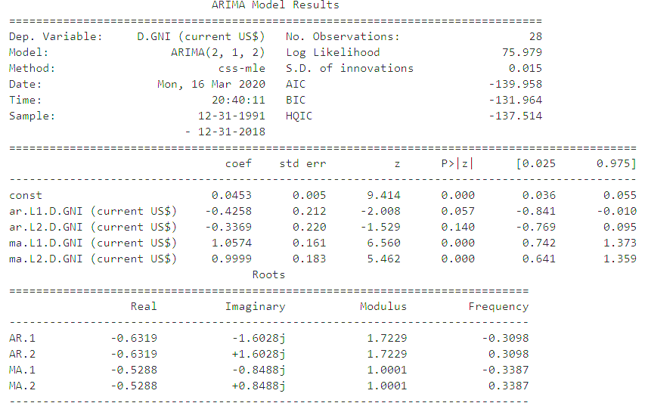
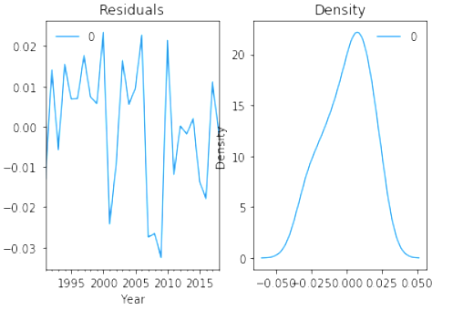
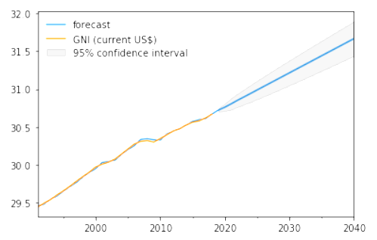
Time Series Analysis (Contd.)

Slide 14
Conclusion
Under this project, we are focusing on the prediction of GDP and economic growth of the country depending on the variation of parameters. This project also covers the different factors which can boom or burst the economy thus helpful for economists to bring superior plans to promote the nation's growth.
Kneighbour Regression is best model to predict with higher accuracy and lowest Error.
Second best model is Linear Regression model with Label Encoder.
Time Series Analysis can be done to have future forecasted value.
ARIMA TS model is best for predicting future values. Here we did it for next 20 years with 95% confidence.
ARIMA model is used to predict GNI for the attributes highly corelated with GDP. The predicted value is till 2040.
Limitation & Future Scope
------------------------------------------------------------------------------------------------------------------
Currently, we are having the limited data which are made public from IMF and WorldBank so the analysis is done based on those data. Also, the data is not rich for all parameters or indicators thus more rich data will give a better prediction.
Data for lower income group countries are not available so more rich dataset is needed.
To have better Time-Series calculation data needs monthly level data instead of annual data.

Slide 15
WorkLoad Distribution
This project is collective effort of all four participants but would like to highlight some major highlights of efforts made:
Data Acquisition and Preprocessing
Aishwarya Ravi
Awanish Tiwari
Data Modification and Final Dataframe
Abhinav Mani Tripathi
Awanish Tiwari
Nupur Roy Chowdhury
EDA
Awanish Tiwari
Nupur Roy Chowdhury
Modeling
Abhinav Mani Tripathi
Aishwarya Ravi
Awanish Tiwari
Nupur Roy Chowdhury
Time Series Analysis
Abhinav Mani Tripathi
Awanish Tiwari
Scoping, Scripting and Responses
Awanish Tiwari

Slide 16
Q & A ?
Thank you!!!...

